Slide 1
Women for Water and Sanitation Uganda
Presented By: Sheba Bamwine Mukiza
National Water and Sewerage Corporation, Uganda

Slide 2
Background
National Water and Sewerage Corporation (NWSC) is a public utility company fully owned by the government of Uganda.
Our Vision is “To be the Leading Customer Centred Water Utility in the World”.
Our Corporate Mission is “To sustainably and equitably provide cost effective quality water and sewerage services to the delight of all stakeholders while conserving the environment”.

Slide 3
History of the Association
NWSC recognises the significant contribution of women towards the attainment of the NWSC vision and mission and as such established the Women for Water and Sanitation (W4WaSU) Network.
The Association Women For Water and Sanitation Uganda was established in April 2017. The Association is chaired by Dr. Rose Kaggwa.
Membership currently is at 67 members and growing steadily

Slide 4
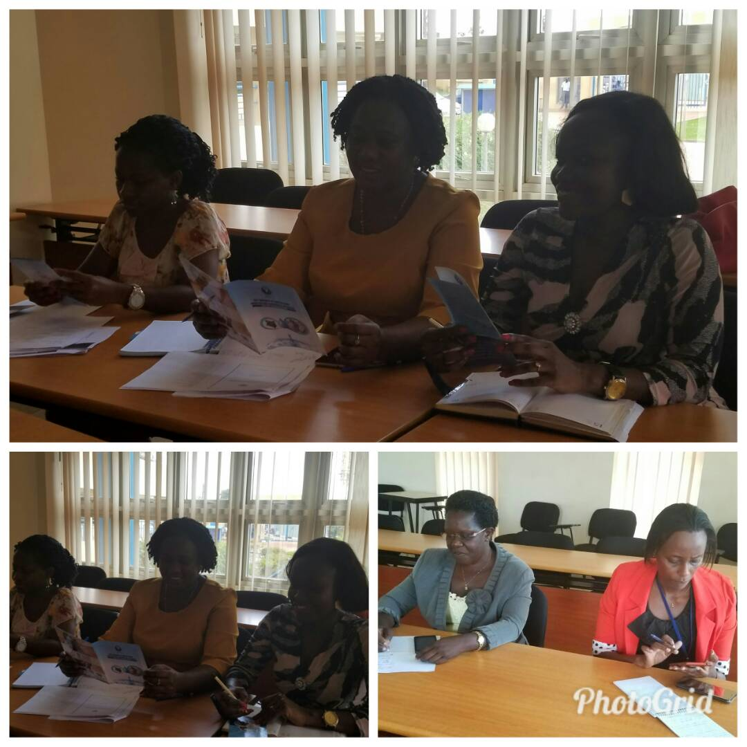
Vision and Mission
VISION: To be a leading transformational network that empowers women in water and sanitation
MISSION: To support, inspire and encourage professional and career development of women while strengthening community outreach regarding water and sanitation activities.

Slide 5
Objectives
OBJECTIVES:
To promote knowledge and experience sharing, skills development and coaching of women in various aspects related to water and sanitation.
To provide a platform of mentorship for the young water professionals and girls in Schools and Water Sanitation Clubs (SWAS Clubs)
To promote and contribute to national and international initiatives of water and sanitation on matters of mutual interest and enhance collaboration and networking among members.
To raise the profile of women in the management of water and sanitation.
To contribute to meaningful shifts in policy.

Slide 6
ACTION PLAN 2017/2018
DELIVERABLE | ACTIVITIES | BY WHEN
Establish the network | Prepare all necessary approvals and documents Finalize Constitution Appoint committee Design brand material (Logo) Officially launch the network | January, 2018
2. Call for Membership | Design membership form Carry out sensitization to grow membership | January, 2018
3. Continuous Professional Development | Conduct at least two training and mentorship programs | December, 2018
4. Community outreach and sensitization | Carry out WaSH outreach programs in partnership with SWAS clubs and YWPs | Sept, 2018

Slide 7
Action Plan ctd..
DELIVERABLE | ACTIVITIES | BY WHEN
5. Capacity Building and training of members | Organize at least two capacity building workshops every year Organize an annual women's power dialogue to discuss issues of WaTSAN Carry out quarterly mentorship programs for the SWAS and YWPs | June, 2018 Quarterly
6. Conduct annual members events | Hold an annual General Meeting Participate and contribute towards the international women's day and World water day celebrations Host an annual women's networking dinner | October, 2018
7. Publish and disseminate W4WaSU literature | Publish the first W4WaSU magazine Support members to publish in journals and present on local and international fora | November, 2018

Slide 9
Way forward
In order to ensure the network meets its key objectives and reaches out to hundreds of women across the region, there is need to seek for membership within NWSC, government and private sector, WaSH sector and friends of Water and Sanitation

Slide 10
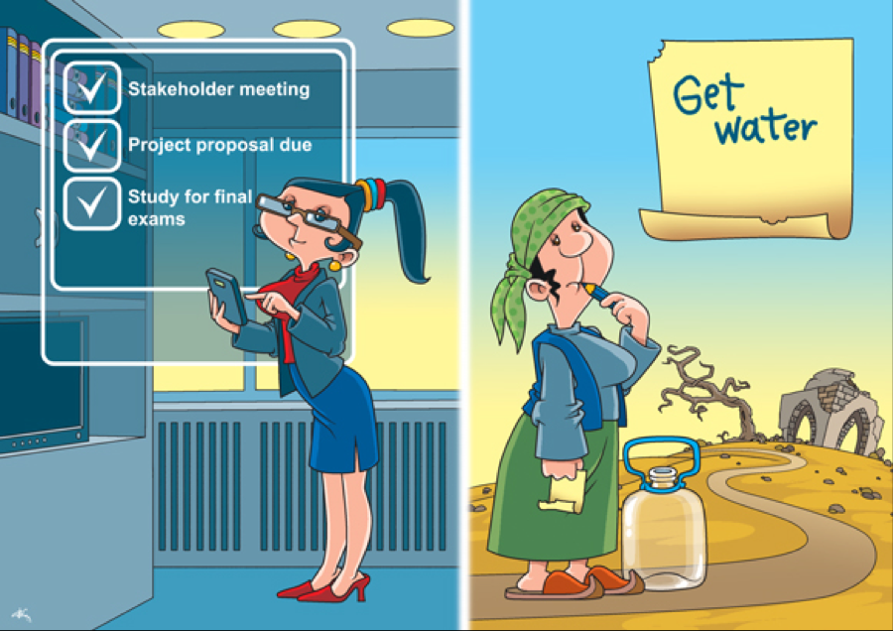

Slide 11
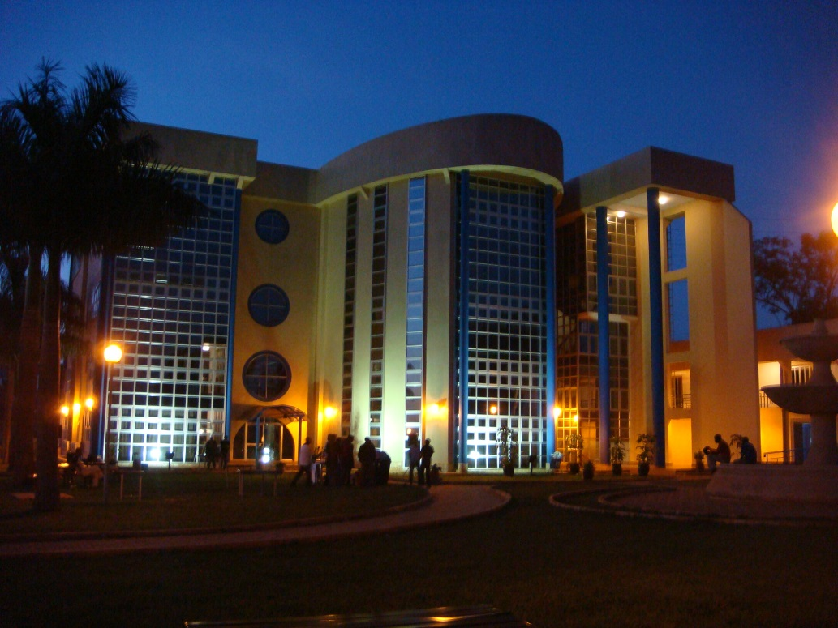
Thank you for your attention

