Slide 1
WATER IS LIFE, SANITATION IS DIGNITY

Slide 2
Globally 2.6bn people do not have access to basic sanitation

Slide 3
In Numbers
2.1bn people globally use pit latrines*
* Source: WHO Unicef Joint Monitoring Programme,, 2015
** Source: BMC Public Health, 2016

Slide 4
In Numbers
53% of URBAN population in Sub-Saharan Africa use Pit Latrines**
* Source: WHO Unicef Joint Monitoring Programme,, 2015
** Source: BMC Public Health, 2016

Slide 5
Impact on Groundwater Quality*
Pit latrines generally lack a physical barrier, e.g. concrete, between stored excreta & soil / groundwater
* Source: Environmental Health Perspectives, 2013

Slide 6
Impact on Groundwater Quality*
This presents a threat to
Human health through
well-water contamination
* Source: Environmental Health Perspectives, 2013

Slide 7
Impact on Groundwater Quality*
Contaminants of groundwater
have a travel distance of up to
50m from pit latrines
* Source: Environmental Health Perspectives, 2013

Slide 8
Impact on Groundwater Quality*
There are unsafe concentrations
of bacteria, viruses, & chemicals
That can be found 26m from away
from pit latrines
* Source: Environmental Health Perspectives, 2013

Slide 9
Impact on Groundwater Quality*
Contaminants include:
Microbiological
(among them B. Coli)
Chemical (Nitrate, Chloride,
Ammonia)
* Source: Environmental Health Perspectives, 2013

Slide 10
Other Health Concerns*
The faecal smell attracts Flies &
Mosquitoes
* Source: Pit Latrines: A Public Health Concern in Africa,
** Source: Preliminary studies developing methods for the control of Chrysomya putoria, the African latrine fly, in pit latrines in The Gambia

Slide 11
Other Health Concerns*
Flies lay eggs in feces, further
spreading diseases
* Source: Pit Latrines: A Public Health Concern in Africa,
** Source: Preliminary studies developing methods for the control of Chrysomya putoria, the African latrine fly, in pit latrines in The Gambia

Slide 12
Other Health Concerns*
The average pit can produce 100 000
flies annually**
* Source: Pit Latrines: A Public Health Concern in Africa,
** Source: Preliminary studies developing methods for the control of Chrysomya putoria, the African latrine fly, in pit latrines in The Gambia

Slide 13
Other Health Concerns*
Related diseases include Hepatitis A, Protozoal, E. Coli, etc
* Source: Pit Latrines: A Public Health Concern in Africa,
** Source: Preliminary studies developing methods for the control of Chrysomya putoria, the African latrine fly, in pit latrines in The Gambia

Slide 14
Other Health Concerns*
Some diseases spread by Mosquitoes
that are well documented - Malaria,
Zika Virus, West Nile Virus, Dengue Fever
* Source: Pit Latrines: A Public Health Concern in Africa,
** Source: Preliminary studies developing methods for the control of Chrysomya putoria, the African latrine fly, in pit latrines in The Gambia

Slide 15
Other Health Concerns*
Poorly built latrines also make for
favorable environments for hookworm
& the transmission thereof
* Source: Pit Latrines: A Public Health Concern in Africa,
** Source: Preliminary studies developing methods for the control of Chrysomya putoria, the African latrine fly, in pit latrines in The Gambia

Slide 16
WATER IS LIFE, SANITATION IS DIGNITY

Slide 17
Organico
A blend of natural, environmentally friendly enzymes, micro-organisms & bacteria

Slide 18
Organico
Degrade faecal, biological & organic waste by stimulating microbes in the pit to degrade sludge

Slide 19
Organico
Through the fragrance in the formulation, & the action of degrading waste, it eliminates odours

Slide 20
Organico
Non-harmful to people, animals, plant life or the environment

Slide 21
Organico
Able to function under various environmental conditions

Slide 22
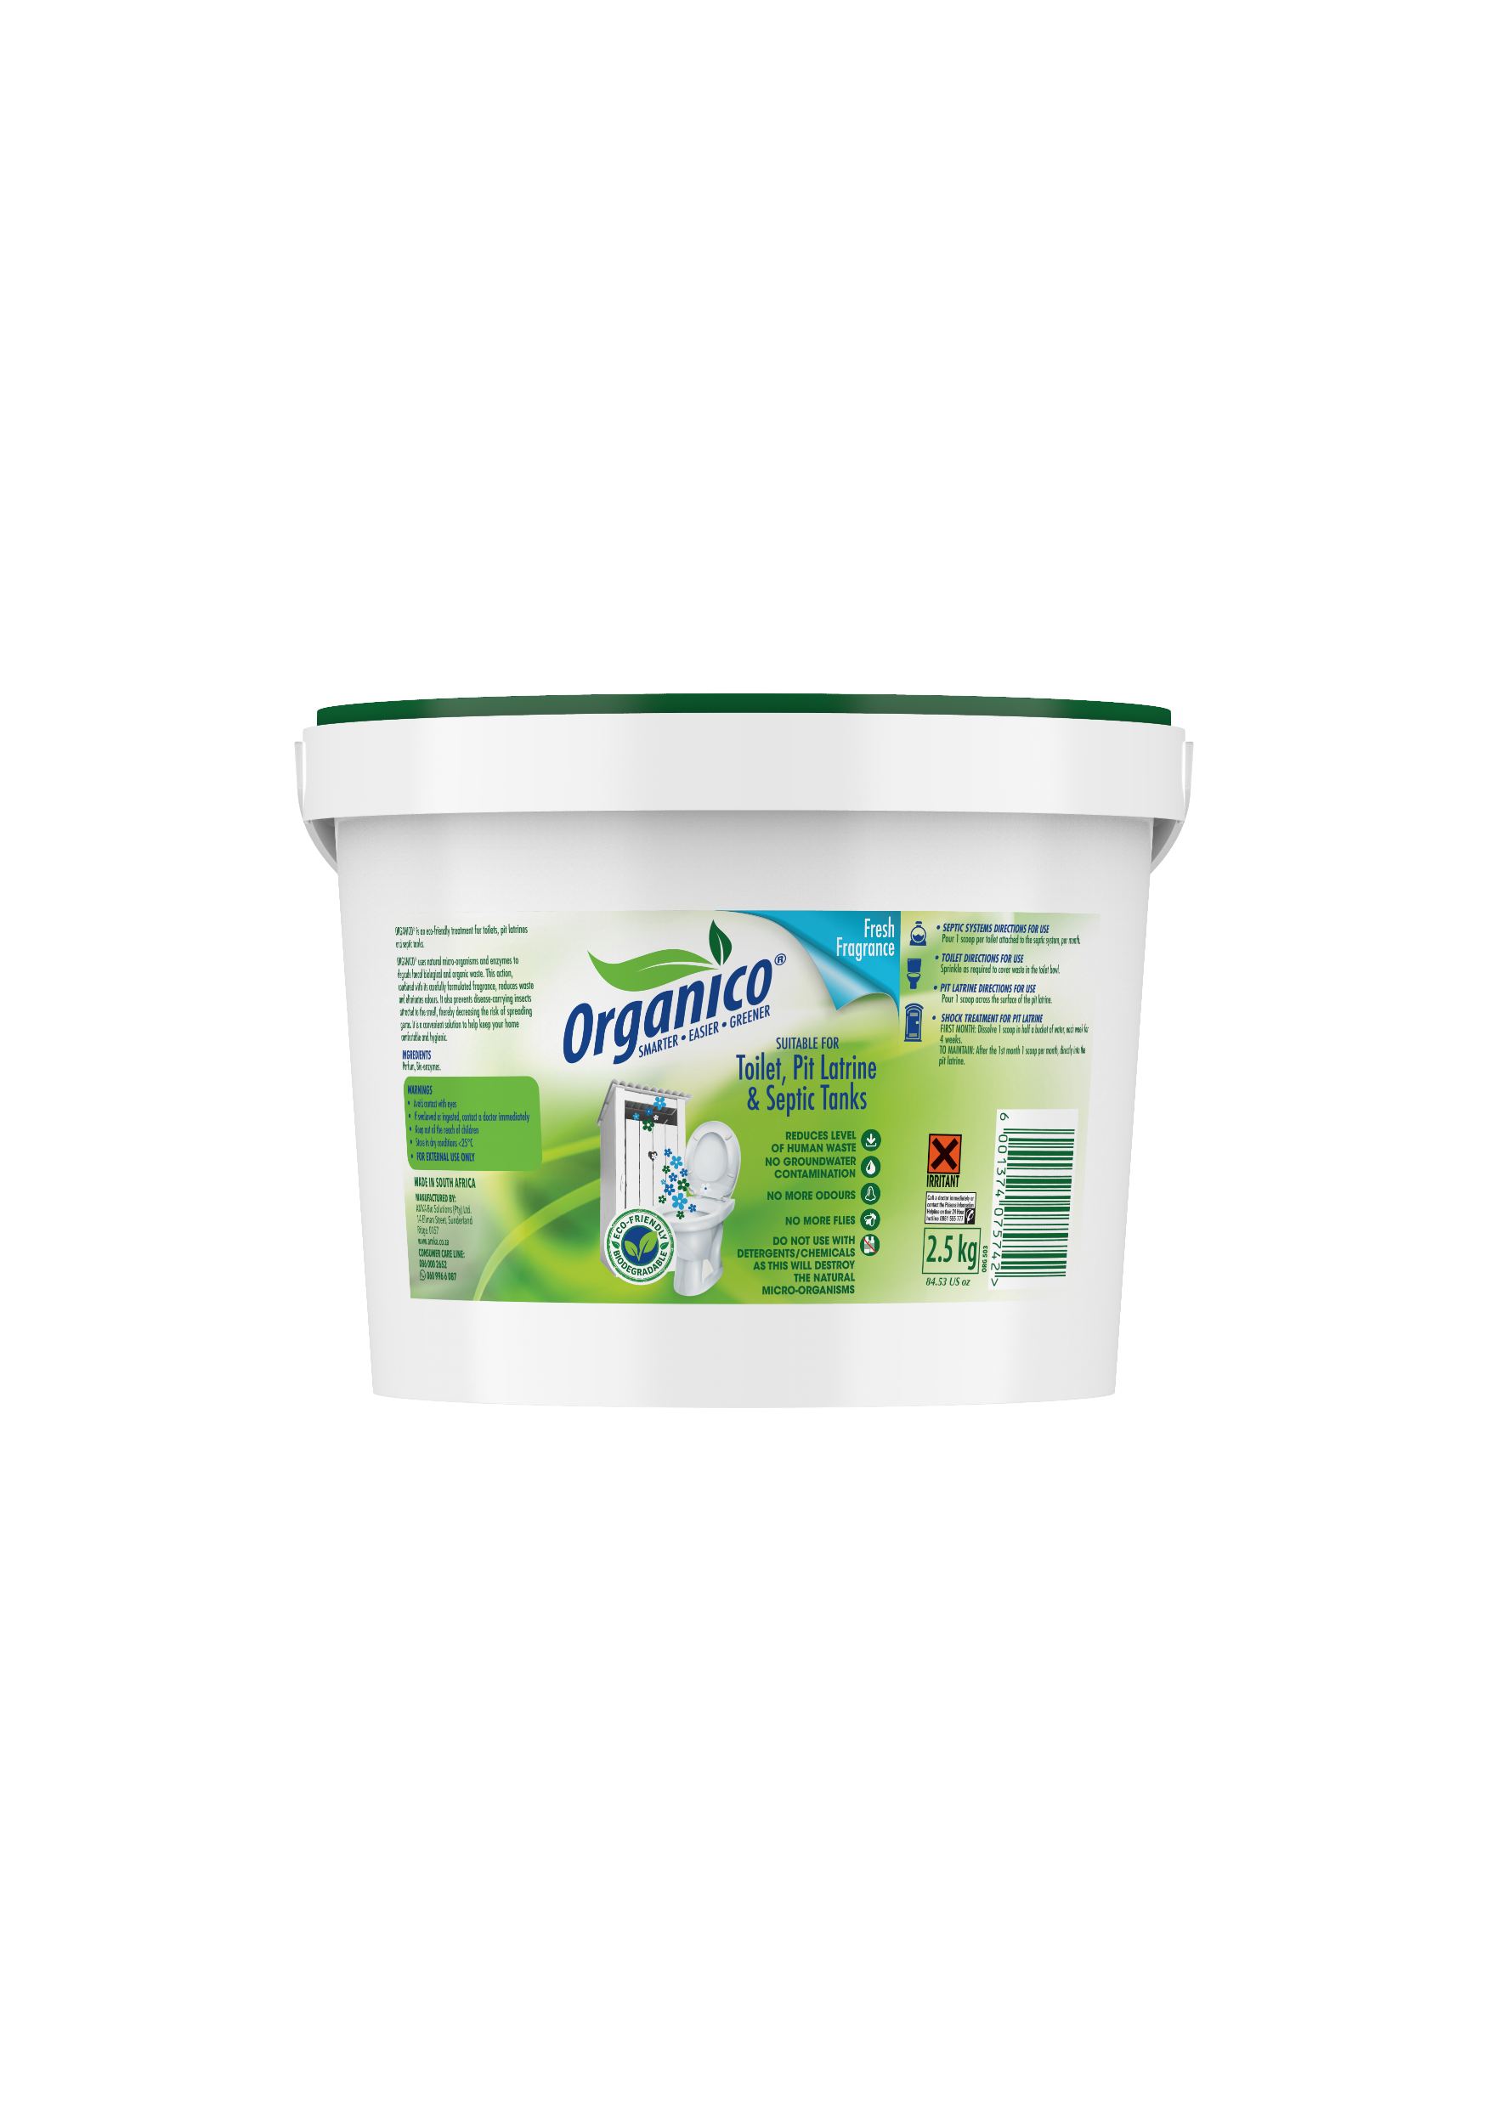
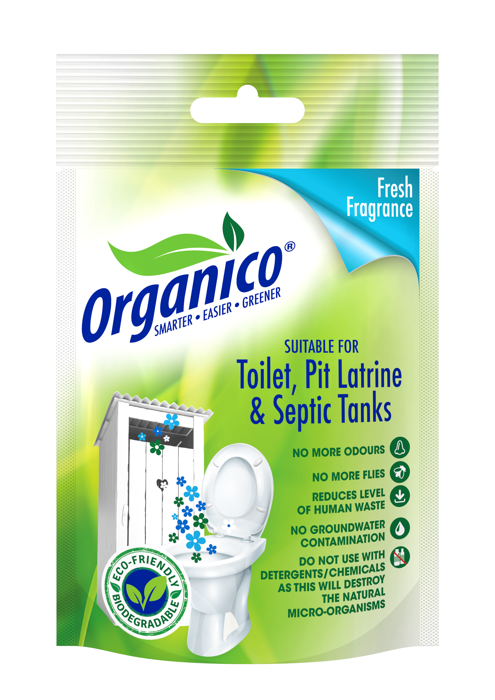
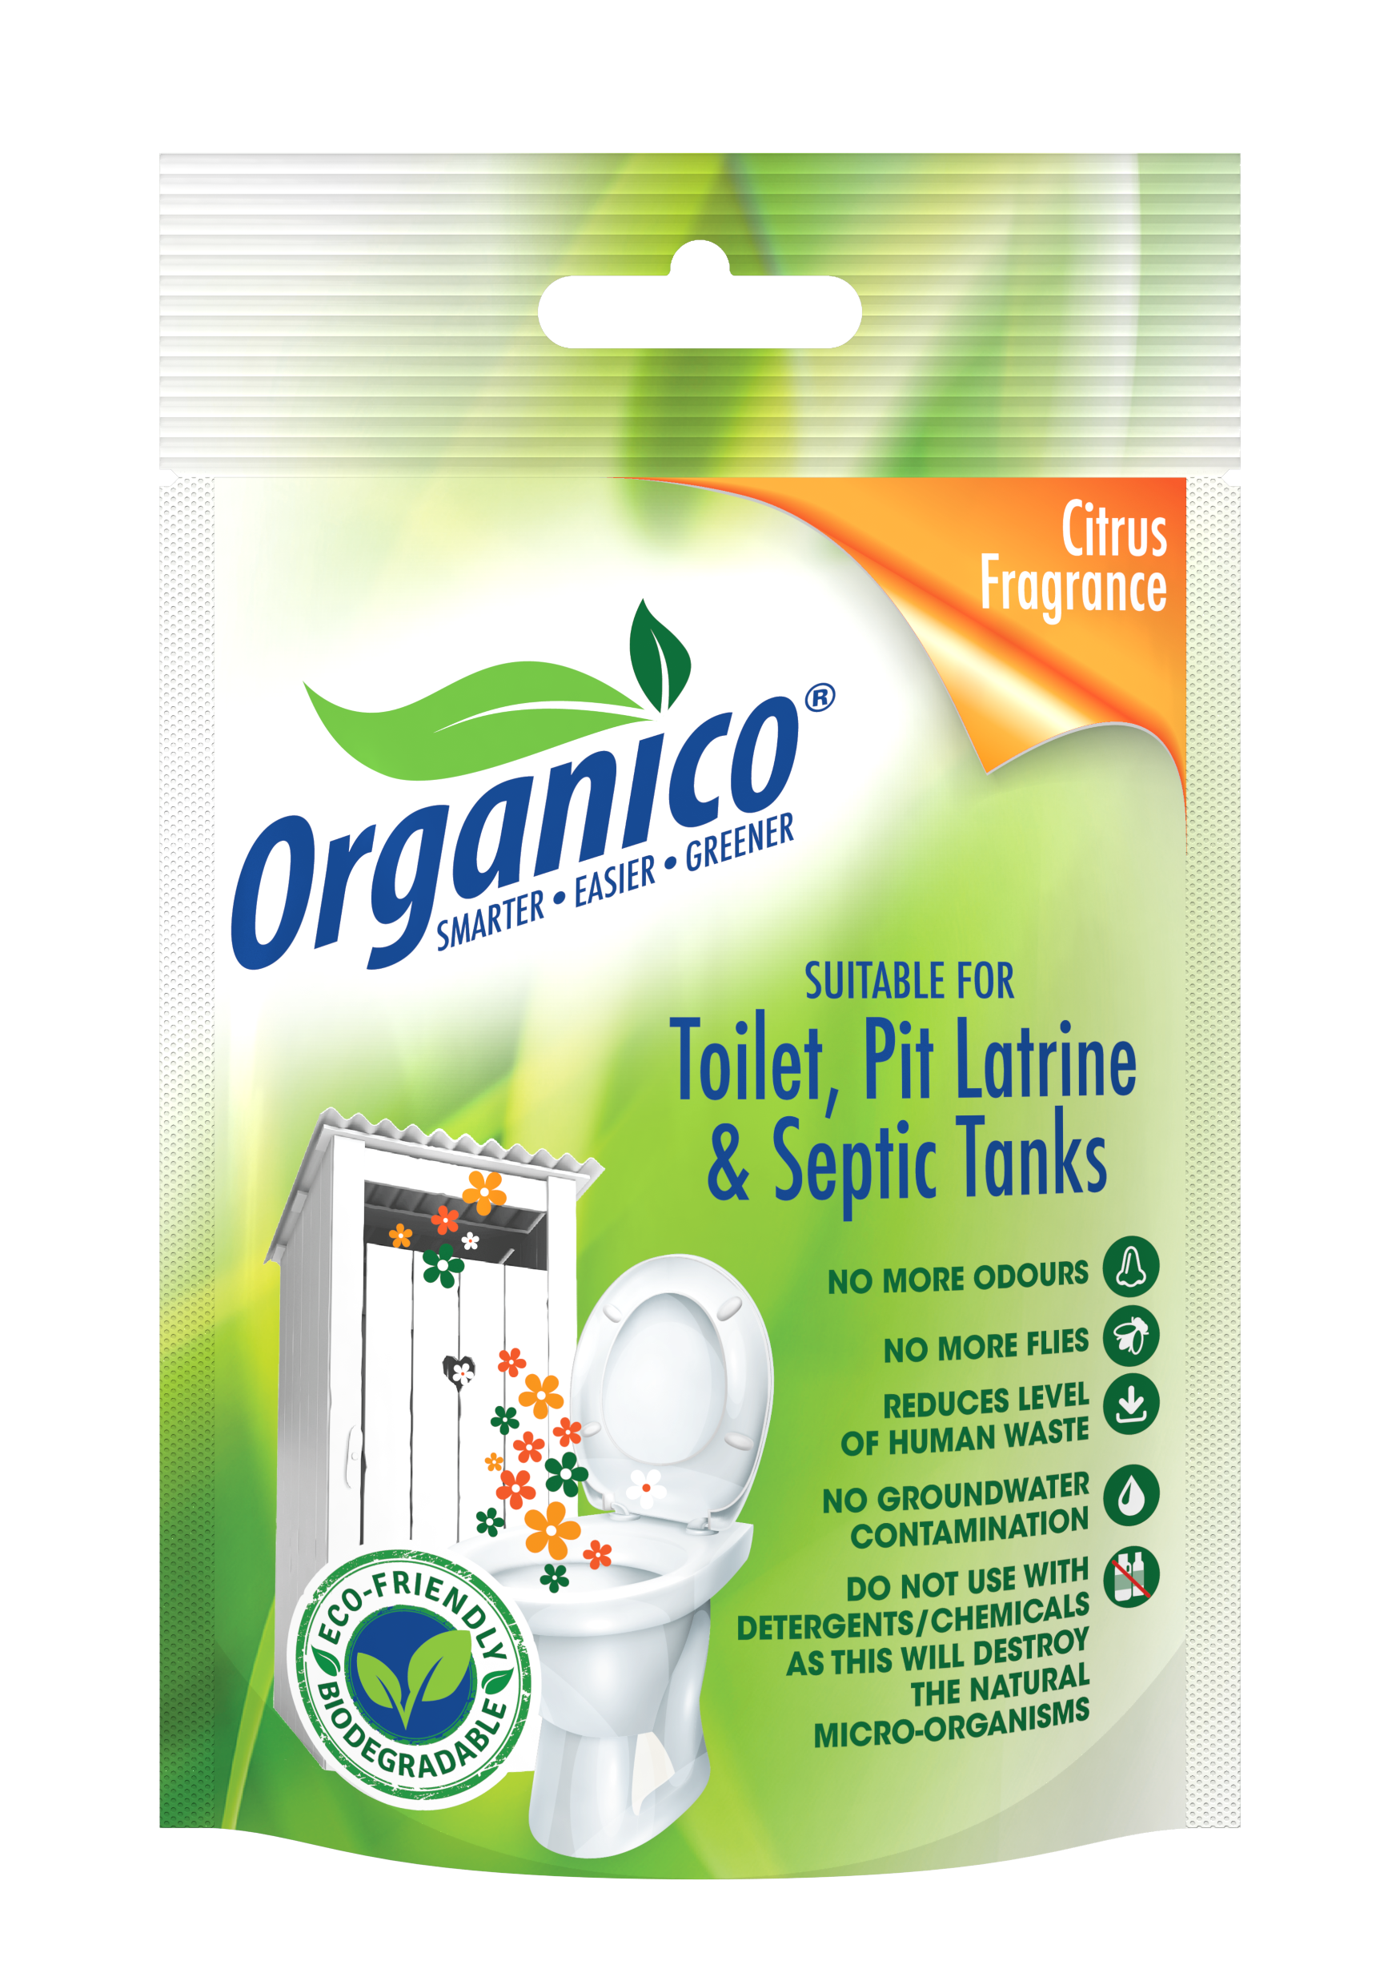
What are the By-Products
Given the organic & biological degrading process, the only by-products are:
Water
Gas (primarily methane)
2.5Kg
100g

Slide 23
What are the By-Products
Easily absorbed into soil without contamination of groundwater or surrounding areas
2.5Kg
100g

Slide 24
Associated Benefits
Reducing fecal smell, reducing the:
Incidence of flies
Incidence of mosquitoes
X
X

Slide 25
X
Associated Benefits
Thus reduces the risk of associated diseases
X

Slide 26
Usage & Cost?*
Cost per sachet: R 30.00
Maintenance cost per annum (12 sachets): R 360.00
Shock plus Maintenance per annum (15 sachets): R 450.00
Cost per 2.5kg bucket: R 500.00
Maintenance cost per annum (12 scoops): R 240.00
Shock plus Maintenance per annum (15 scoops): R 300.00
*application cost per toilet for 1 year maintenance and shock treatment

Slide 28
Together, we have the opportunity to provide citizens of the world the basic human right which is access to safe sanitation!

Slide 29
WATER IS LIFE, SANITATION IS DIGNITY

